Slide 1
Capstone Project- 3
Mobile Price Range Prediction Supervised Machine Learning
(Classification)
BY
Ashish Panjabrao Wasnik

Slide 2
Content
Problem statement
Data summary
EDA
Modelling
Metrics
Challenges
Conclusions

Slide 3
Problem Statement
The problem statement is to predict the price range of mobile phones based on the features available (price range indicating how high the price is). Here is the description of target classes:
0 - Low cost Phones
1 - Medium cost phones
2 - High cost phones
3 - Very High cost phones
This will basically help companies to estimate price of mobiles to give tough competition to other mobile manufacturer.
Also, it will be useful for consumers to verify that they are paying best price for a mobile.

Slide 4
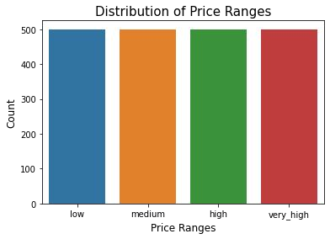
Data Summary
We have records of 2000 mobile phones with 20 columns/features.
We have perfectly balanced dataset with 500 observations for each class.
Each column represents the feature of the mobile.
Interestingly , we had zero null values.

Slide 5
Data Overview
Battery_power - Total energy a battery can store in one time measured in mAh
Blue - Has bluetooth or not
Clock_speed - speed at which microprocessor executes instructions
Dual_sim - Has dual sim support or not
Fc - Front Camera megapixels
Four_g - Has 4G or not
Int_memory - Internal Memory in Gigabytes
M_dep - Mobile Depth in cm
Mobile_wt - Weight of mobile phone
N_cores - Number of cores of processor
Pc - Primary Camera megapixels
Px_height - Pixel Resolution Height
Px_width - Pixel Resolution Width
Ram - Random Access Memory in MegaBytes
Sc_h - Screen Height of mobile in cm
Sc_w - Screen Width of mobile in cm
Talk_time - longest time that a single battery charge will last
Three_g - Has 3G or not
Touch_screen - Has touch screen or not
Wiﬁ - Has wiﬁ or not
Price_range - This is the target variable with value of 0(low cost), 1(medium cost),2(high cost) and 3(very high cost).

Slide 6
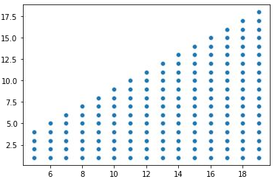
Handling Discrepancies
In the data we observed that in 9% of rows the value for columns 'sc_w' (screen width) is 0, which is not possible in real life.
As we can see in the plot, for each value of 'sc_h' there are multiple values of 'sc_w', so to handle zero values, we replaced them with mean of all available values 'sc_w' for all values of 'sc_h'.
Screen Width (cms)
Screen Height (cms)

Slide 7
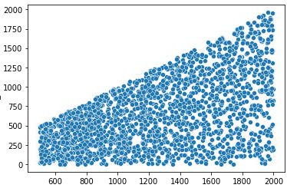
Handling Discrepancies
There are also discrepancies in ‘Px_height’ column.
To handle those discrepancies we replaced those values by using linear regression.
Pixel Height
Pixel Width

Slide 8
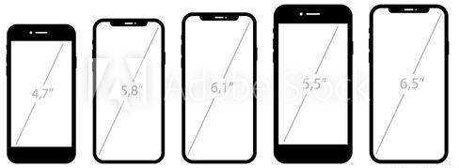
Feature Engineering
Generally the screen size of the phone is expressed in Inches.
We have columns ‘sc_h’ and ‘sc_w’ out of which we have created a new feature ‘Screen_size’ which is diagonal length of the screen.

Slide 9
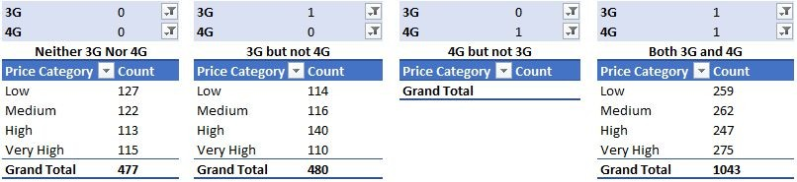
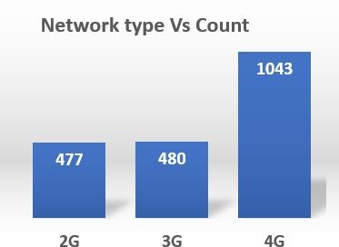
Feature Engineering
We observed that if a phone supports 4G, it by default has₄3_{G}G as well. So we^{4G}don’t really need two columns for this.
We created a single column ‘network’ by the addition of 3G and 4G. Where:
0 - 2G, 1 - 3G, 2 - 4G.
4G 4G

Slide 10
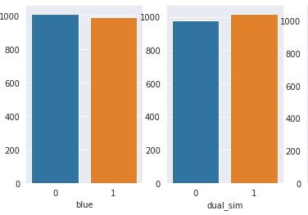
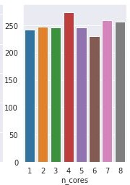
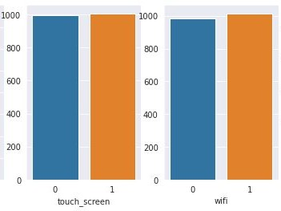
Categorical Analysis
counts

Slide 11
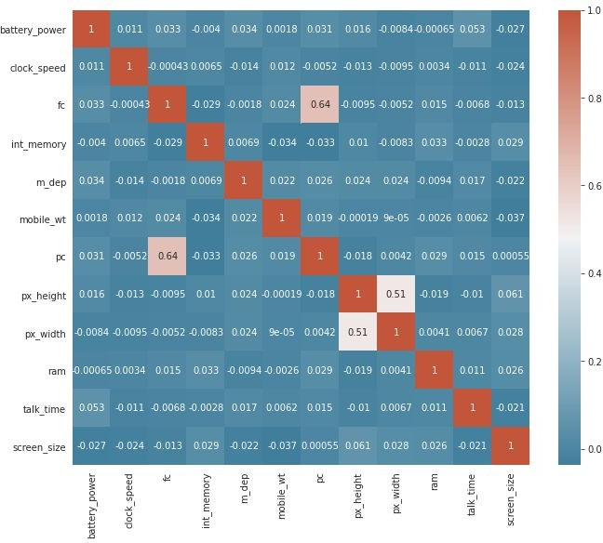
Collinearity
We created a new column ‘Pixels’ by taking the product of ‘px_height’ and ‘px_width’.

Slide 12
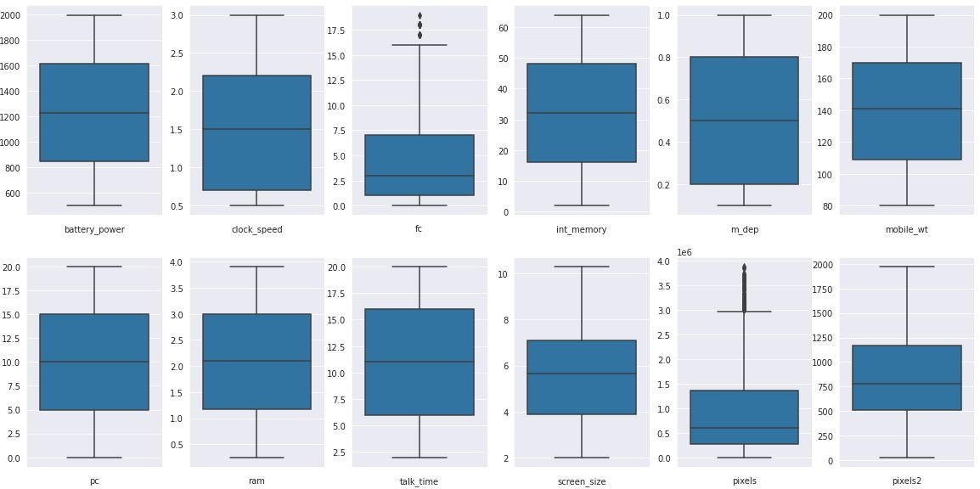
Outlier Analysis in continuous features
There were few outliers in ‘pixels’ column, so to handle outliers we replaced the values of ‘Pixels’ column with the square root.

Slide 13

Predictive Modelling

Slide 14
Hyperparameter Tuning - Grid Search - Cross Validation
We compared 6 classifiers and evaluated them based on overall accuracy & class based accuracy as well.
Decision Trees
Random Forest
Ada Boost
Gradient Boosting
XGBoost
Logistic Regression

Slide 15
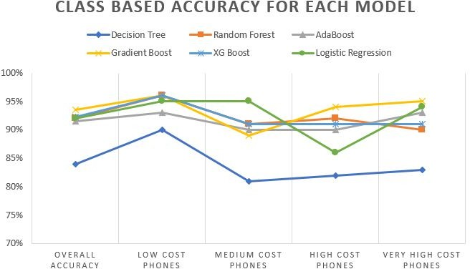
Comparison of Models

Slide 16
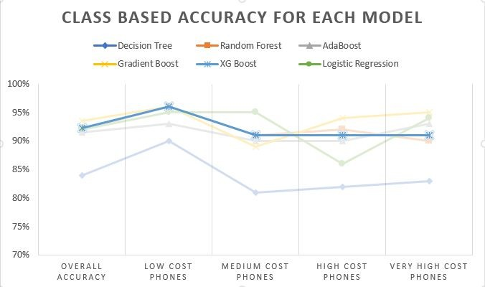
Comparison of Models
XG Boost is the best performing model on the given dataset

Slide 17
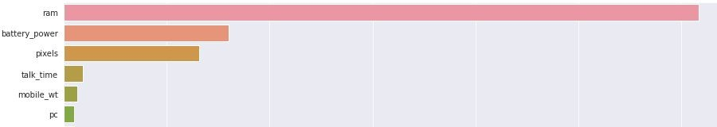
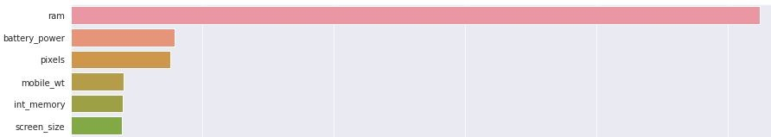
Feature Importance
Decision Tree
Random forest

Slide 18
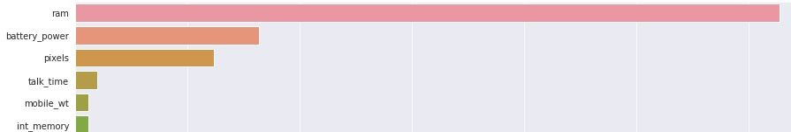
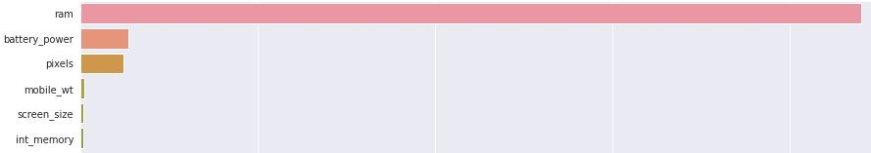
Feature Importance Contd..
Ada Boost
Gradient Boost

Slide 19
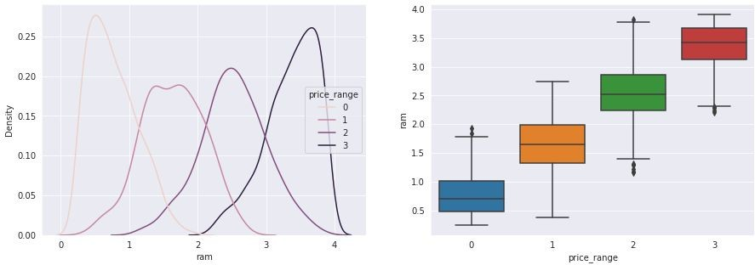
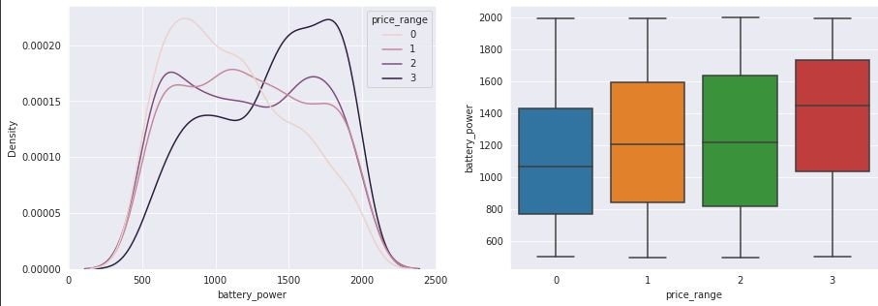
Feature Importance Contd..
RAM and battery power are two most important features for the models.
RAM and Battery power show the most variation along the different price ranges.

Slide 20
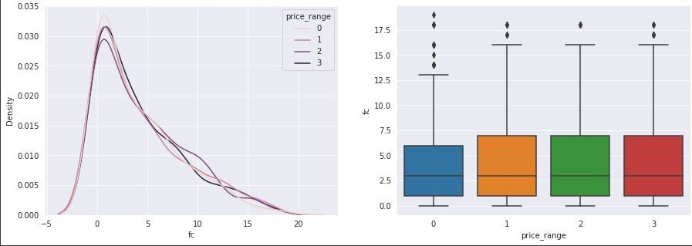
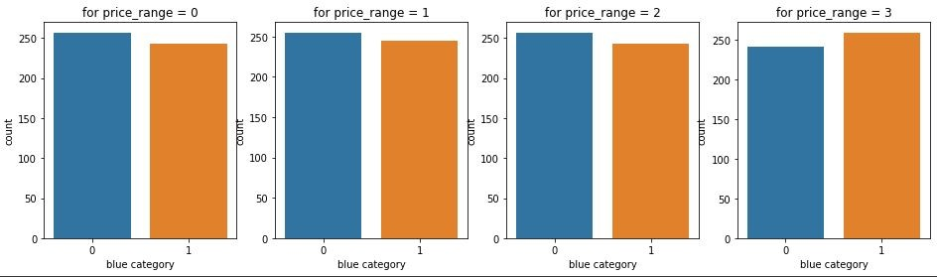
Feature Importance Contd..
Apart from selected important features any feature doesn’t show variation along the different price ranges.
Here is example of front camera and bluetooth.

Slide 21
Challenges
We performed “Hypothesis driven EDA” based on domain, but unluckily most of our hypothesis got rejected by our data.
Most of the models are not able to get good accuracy for each class of target variable.
We hit a ceiling at 94% accuracy using a single model.

Slide 22
Conclusion
Gradient Boost, Random forest and ADABoost Models are also giving us good overall accuracy but they didn’t perform well on Individual classes.
Out of all the model we have tried XG Boost is performing well on Overall as well as Individual classes.
Ram, Battery power, Mobile weight, Screen size and pixels are key features in predicting the mobile price range.
Most of the mis-classiﬁcations were encountered between Medium range phones and high range phones. To counter that we can train a speciﬁc model for these two classes and can reclassify the cases when base model predicts the result as Medium range or High range.

Slide 23
Thank
You

